Slide 1
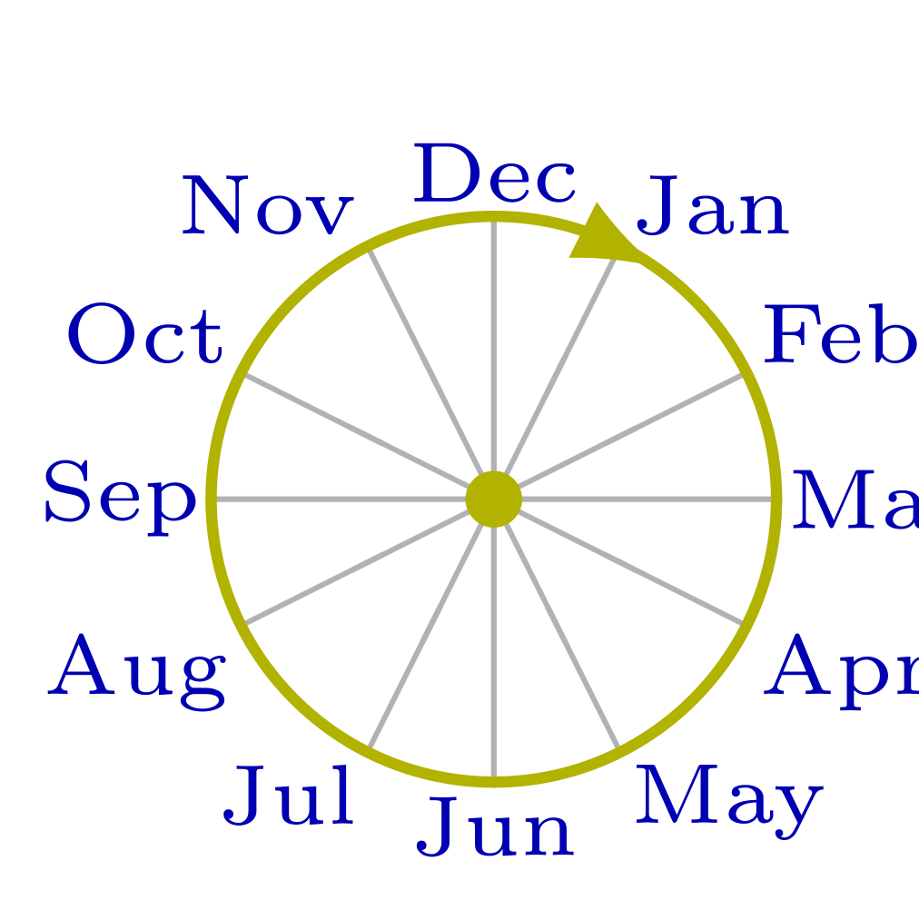
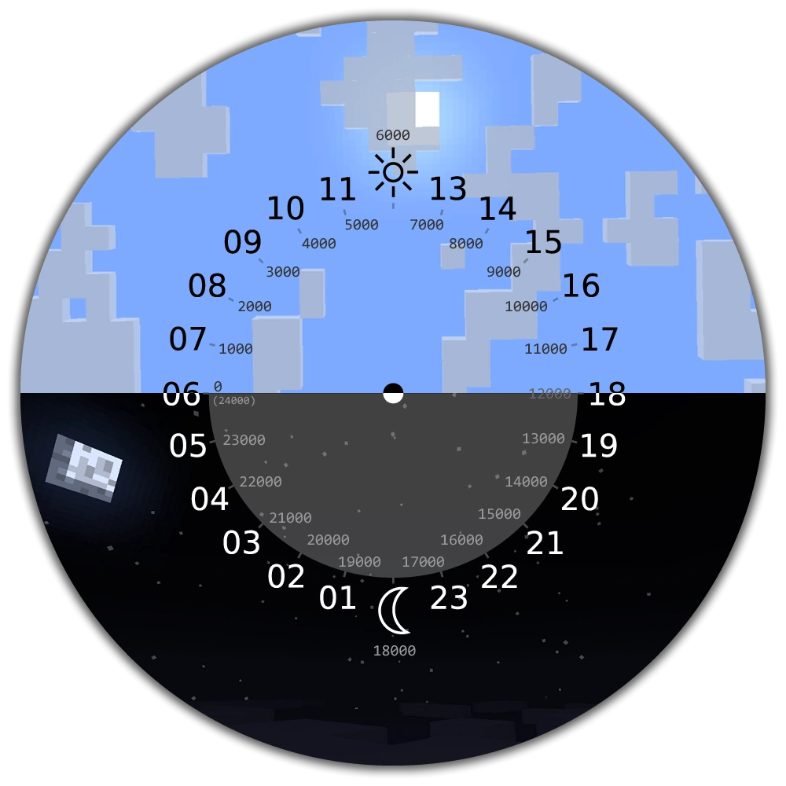

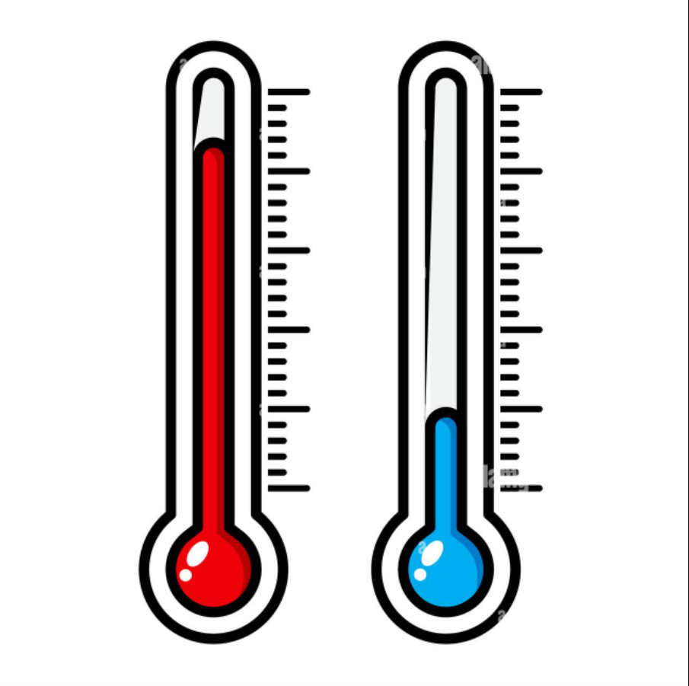
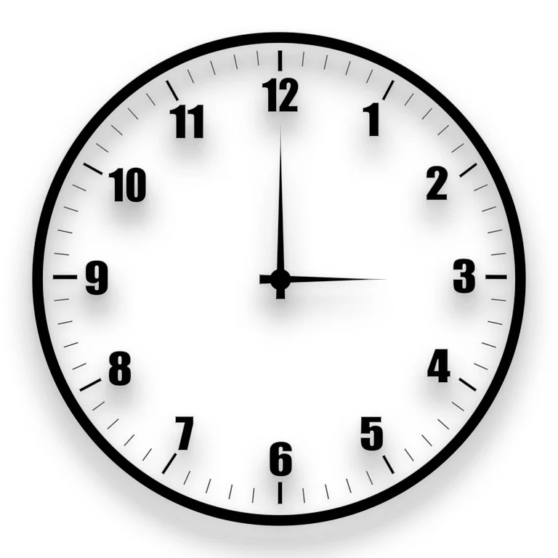

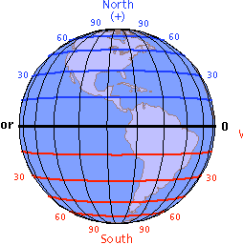
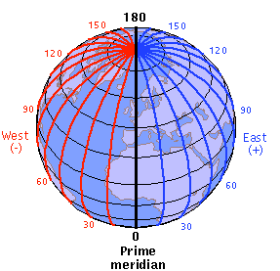

Flight Delay
Under-stand
The usual Atlantic hurricane season has a major effect on the Flight Delay, which peaks from June to August.
The day of the month doesn’t seem to have any real effect on the Fight Delay time.
Wind speed around 2~4 m/s have the highest occurrences of Flight Delay, but the correlation is not strong.
Temperature from 15 to 25 Celsius has the highest amount of Flight Delay. This might be due to
Month
Day
Wind Speed
Temp
Flight Delay
Flight delay can be a major downside for taking commercial aviation. It is of paramount importance to understand what might cause a flight delay in order to make better predictions ahead of time.
Clouds
Latitude
Longitude
Depart Time
Holder
Holder
Holder
Holder

